Slide 1
How To Learn And Learn Fast
MADE BY KHOI NGUYEN
“Learning is not supposed to be easy and if it’s hard you’re doing something right.”

Slide 2

About me
My name is Khoi Nguyen(Ryan). I am currently a senior student majoring in Computer Science at Ton Duc Thang University.
In addition to my studies, I also work as a part-time teacher at Teky Academy. It's a role that allows me to share my knowledge, inspire curiosity, and contribute to the growth of young learners.
Email: doanthekhoinguyen.dev@gmail.com
Phone number: 84 921 037 314

Slide 3
Table of contents
01
Introduction
02
Tips how to learn faster
03
Benefits of the learning fast
04
Conclusion

Slide 4
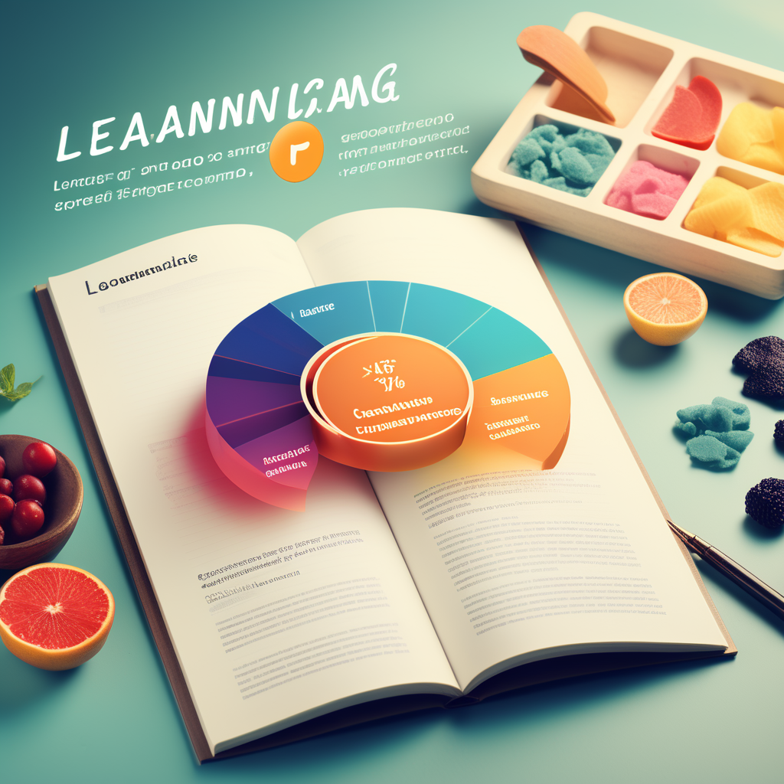
01
Introduction
Importance of learning how to learn

Slide 5

Why we need learn how to learn ?
- Learning how to learn is a meta skill that can have an enormous impact on our lives in everything that we do.
- Spending time on meta learning, such as researching how to learn a skill before actually practicing it, can accelerate the learning process.

Slide 6

02
Tips how to learn faster
“Learning is not supposed to be easy and
if it’s hard you’re doing something right.”

Slide 7

Tip 1: Five minute rule (activation resistance)
Using the 5-minute rule, you set a goal of doing whatever it is you would otherwise avoid, but you only do it for a set amount of time: five minutes.
If, after five minutes, it’s so horrible that you have to accomplished. Done

Slide 8
Step detail 5 minute rule
4. Dive into the Task
5. Assess Progress
6. Decide to Continue or Stop
1. Identify the Task
2. Set a Timer
3. Commit to 5 Minutes
Now, you have a choice. If you're in the flow, consider continuing beyond 5 minutes. If not, acknowledge the effort and decide on the next steps.

Slide 9

Tip 2: Test yourself (Active Recall)
- Testing ourselves through active recall is crucial for learning anything, and can be applied not just in studying but in any area of learning.
- Active recall or retrieval practice is a counter-intuitive way of learning, where we learn by trying to take stuff out of our brains instead of putting stuff in.

Slide 10
How to practice active recall
01
You must identify the problem
02
Self-solving
03
Reflect

Slide 11
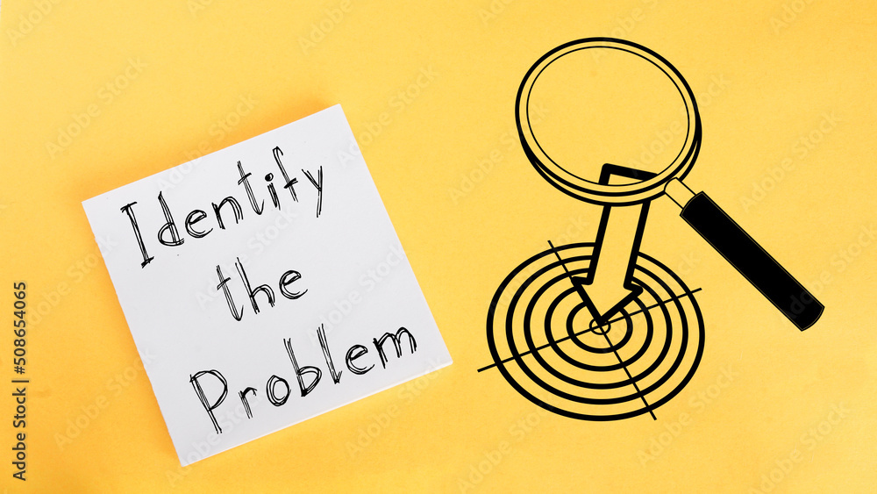
How to practice active recall
Step 1: You must identify the problem
Identify conditions that still exist after reading or studying a lesson or perhaps an issue that you still have questions about or do not understand during the learning process.

Slide 12
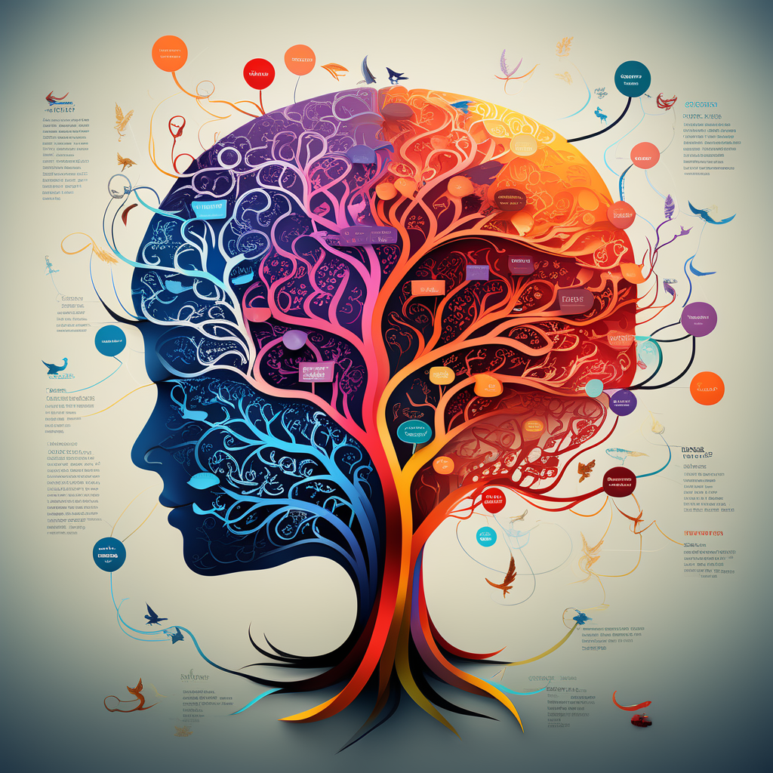
How to practice active recall
Step 2: Self-solving
"Self-solving" can be self-presenting a newly learned knowledge through mind maps, writing, or drawing.
It is also possible at a higher level to find related documents to demonstrate the problem in the lesson, without looking at the notes or explanations of the problem that the teacher taught you at school. .

Slide 13
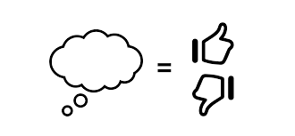
How to practice active recall
Step 3: Reflect
Review the content you have collected and solved for the selected problem, comparing it with the knowledge presented in the textbook. Compare and write conclusions about what you have just done, what has been achieved and what needs to be improved.

Slide 14
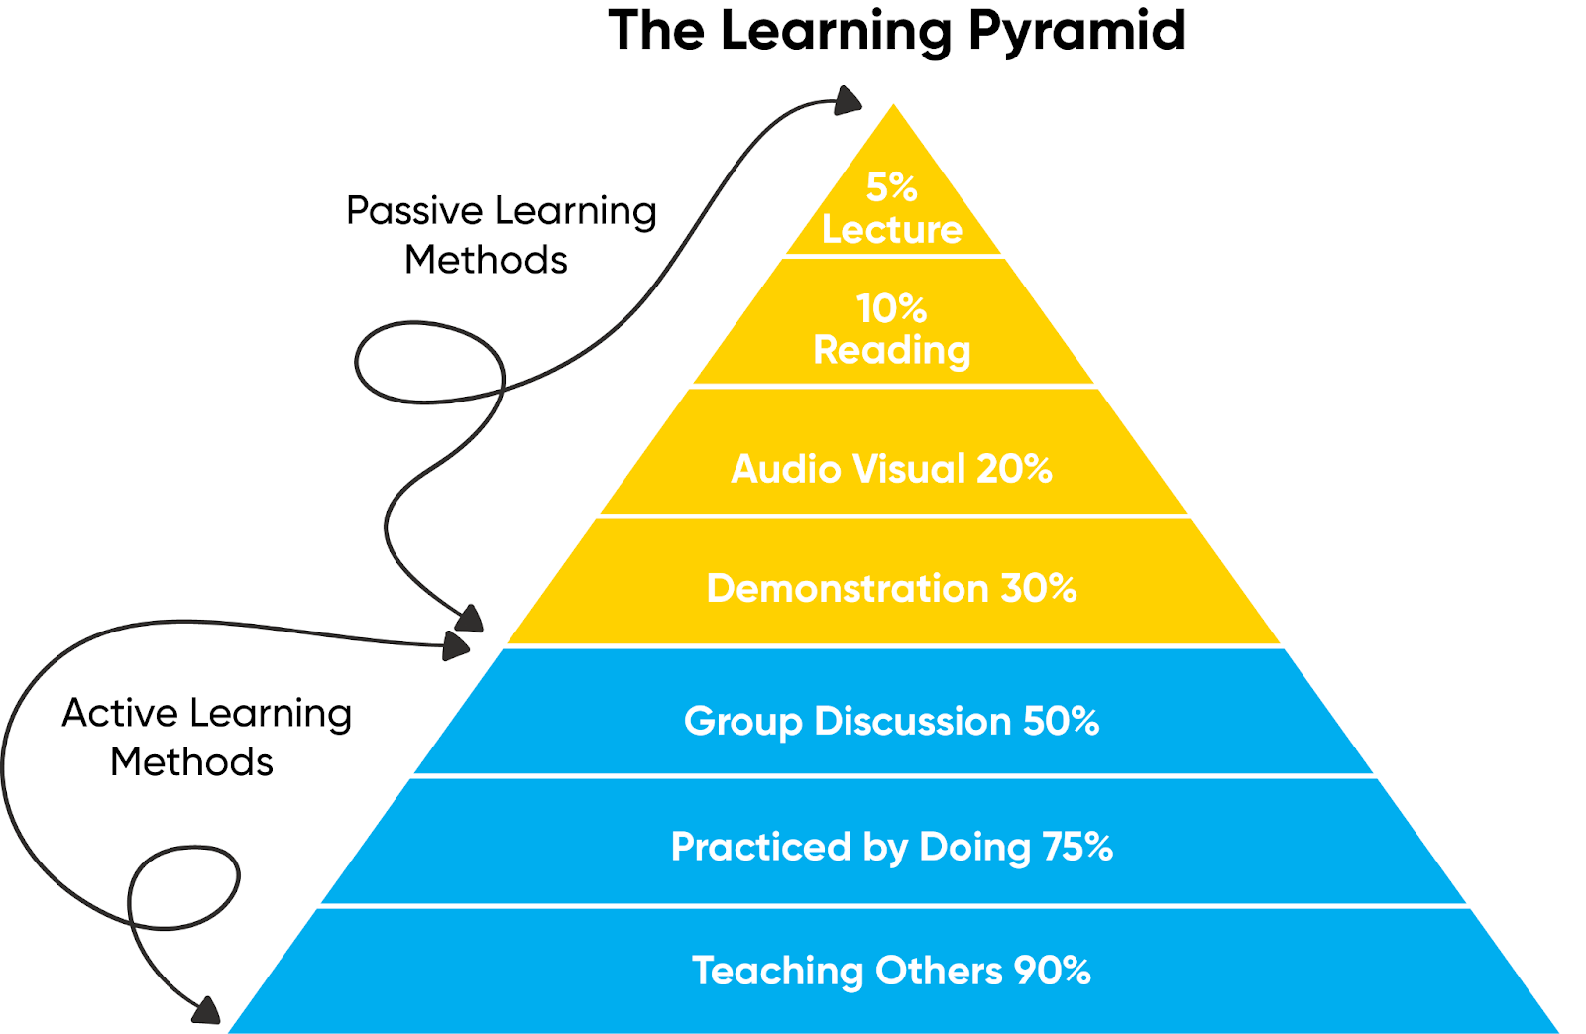
Tip 3: Teach someone else.
- A good way to assess your knowledge before a test is to teach the material that will be tested to someone else.
-In addition to the benefits for the person you are helping, there are several benefits for yourself.

Slide 15

Experience After Applying This Method
Actively teaching others has sharpened my ability to explain complex concepts with clarity. The process of breaking down information for others deepened my understanding.
Teaching not only reinforced my knowledge but also boosted my confidence.

Slide 16
03
Benefits of learn faster

Slide 17
Benefits of learn faster
01
Time Optimization
02
Increased Productivity
Accelerating the learning process enables efficient use of time, freeing up valuable hours for additional pursuits and personal growth.
Quick learning translates to heightened productivity, allowing individuals to accomplish tasks with greater efficiency and effectiveness.

Slide 18
Benefits of learn faster
03
04
Continuous Self-Development
Enhanced Confidence
Mastering the skill of learning faster instills a sense of confidence, empowering individuals to approach new subjects or challenges with assurance.
Learning faster is a catalyst for continuous self-development, empowering individuals to stay ahead in their fields and embrace lifelong learning.

Slide 19

04
Conclusion

Slide 20
The importance of learning: Learning is an important process in everyone's life, helping us to develop ourselves and achieve success.
Effective fast learning methods:There are many effective fast learning methods, including many methods. But you should find your best method match with your study style.
The benefits of fast learning: Fast learning brings many benefits to us, including helping us to succeed in studies and work, adapt to the changing world, and expand our knowledge.

Slide 21
Thanks
Do you have any questions?
Email: doanthekhoinguyen.dev@gmail.com
+84 921 037 314

